Slide 1

Directorate for Entrepreneurship & General Studies, NOUN Certificate in Entrepreneurship Education
Module One
Entrepreneurial Thinking
Dr. awolumate SAMUEL

Slide 2
Intended Learning Outcomes
By the end of this module, you will be able to:
Develop self-directed entrepreneurial ideas;
Provide solutions to an identified gap(s) in your environment/business; and
Apply entrepreneurial thinking skills in your business

Slide 3
entrepreneurial thinking
Entrepreneurship thinking is a complicated multi-faceted challenge which requires a system thinking approach rather than a linear mindset.
It is a way of thinking, reasoning and acting that is opportunity obsessed, holistic in approach and leadership based. ~Jeff Timmons
Systems’ thinking is the only way to create the high-quality entrepreneurs we need for the future
More than just start-ups; It is how systems work over time and within the context of larger systems.
It is all about doing something that has never been done or in a way that has not been done before

Slide 4
Entrepreneurial expertise is the ability and capacity to do and make something out of nothing.
Enterpreneurship is a mind set change. It is also a culture that can be taught, imbibed and cultivated

Slide 5
Entrepreneurship development in teaching and learning
The university should be structured to encourage and facilitate the growth of entrepreneurial attitudes and abilities.
Staff take an entrepreneurial approach to teaching in all departments, promoting diversity and innovation in teaching and learning.
Universities should be delivering their entrepreneurial teaching through a range of methods across all departments.
Teaching and learning development requires collaboration and engagement with external stakeholders.
The Factories lead research and innovation projects involving students, companies and researchers and they benefit from dedicated technologies and facilities.
The university provides support for individuals and groups to move from entrepreneurial ideas to action

Slide 6
Life Skills
Valuable Professional Skills
Entrepreneurship mind set

Slide 7
Life skills
Give the abilities to…
Live and relate with people
Manage the persons around you or your contacts
Cope with different facet of life challenges
Drives you in dealing with daily activities
Motivates your ideas and direct your intuition.
These skills are needed for:
Initiative and self-direction
Risk taking
Flexibility and adaptability
Critical thinking
Problem solving
Creativity and innovation
Creating value

Slide 8
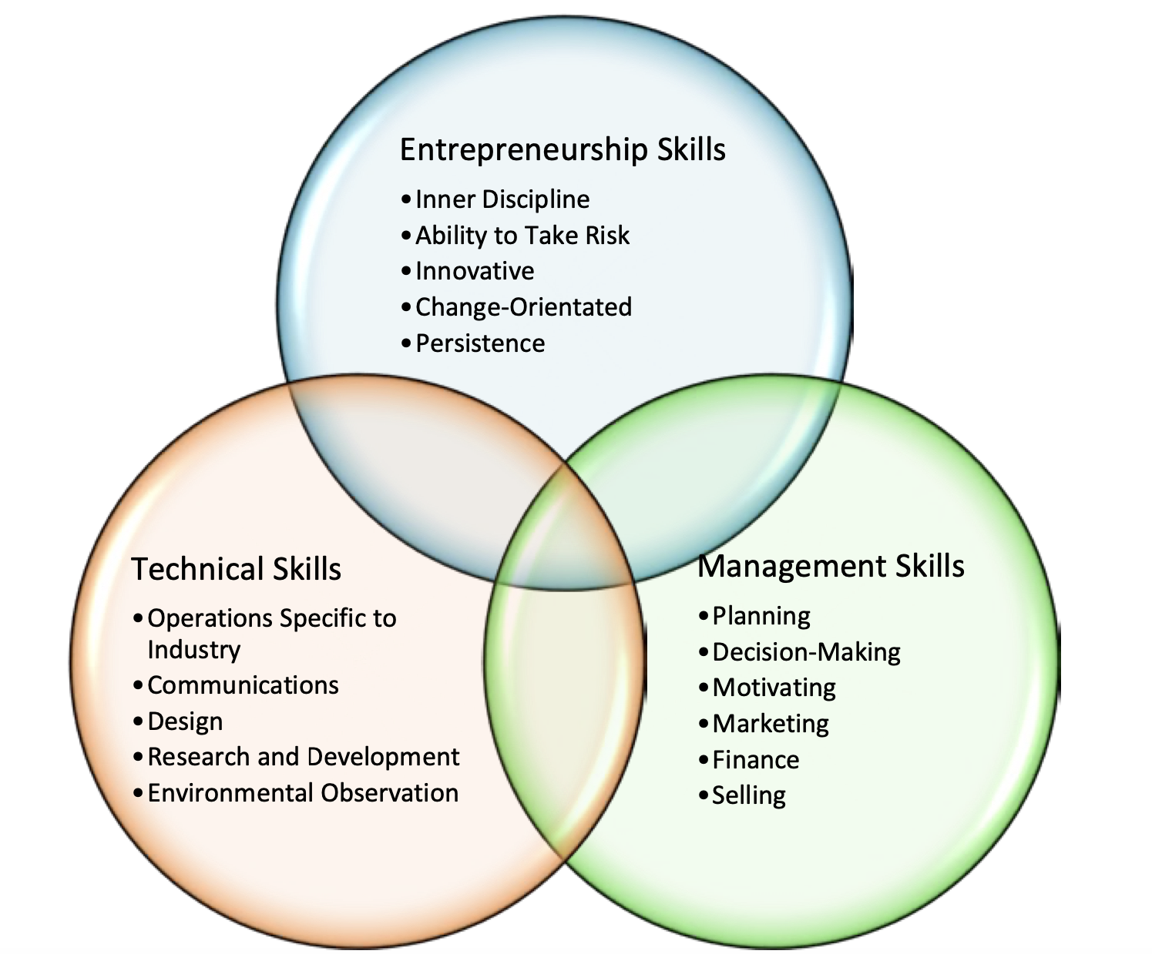
Entrepreneurship Skill-Sets

Slide 9
Developing Entrepreneurial Thinking Skills
Not “Science” i.e., deterministic. That is, if we do A and B and C, we will get outcome D.
Not an “Art” that is abstract and success comes only to a gifted few.
Entrepreneurship is a craft
It is accessible (something that everyone can do) and yet it produces unique products.
It is also learnable because there are fundamental concepts that increase your odds of success.
Like a craft, it should be taught in an pprenticeship model where

Slide 10
Developing Entrepreneurial Thinking Skills Requires;
Project management
Empathy
Systems thinking
Collaboration
Divergent thinking
Handling rejection
Creative risk-thinking
1
2
3
4
5
6
7

Slide 11
Types of entrepreneurships
Innovating Entrepreneur | Imitative Entrepreneur | Fabian Entrepreneur | Social Entrepreneur | Drone Entrepreneur
Introduces new goods, inaugurates new method of production, discovers new market & reorganizes the enterprise | Characterized by readiness to adopt successful innovations inaugurated by successful innovating entrepreneur. | Are characterized by very great caution and scepticisms in experimenting any change in their enterprise. | Start-ups and entrepreneurs develop and fund solutions that directly address social issues | Are characterized by refusal to adopt opportunities to make changes in production formulae even at the cost of severely reduced returns.

Slide 12
Attributes of an Entrepreneur
Self- motivated
Versatility
Flexible
Team player
Creativity
Visionary
Risk bearer
Decisiveness
Focus on impact than profit

Slide 13
developING entrepreneurial thinking skill into business or innovation
“Those who are able to identify problems or opportunities and then work to generate creative solutions to those issues can also improve situations in their personal lives,” ~Livengood
Some men see things as they are, and ask why. I dream of things that never were, and ask why not.” — Robert Kennedy paraphrasing George Bernard Shaw

Slide 14
entrepreneurial thinking skill into business or innovation
Your Idea
Their Need

Slide 15
How to develop entrepreneurial thinking skill into business or innovation
Train yourself to use your talents and experience to see opportunities
Clarify your reasons and your goals. Why are you doing this? What do you hope to achieve?
Understand your entrepreneurial personality. Who are you? What makes you tick?
Map your skills and experience. What can you do? What do you know?
Leverage your relationships and resources. Who can help you? What assets are available for your use?
Position yourself for high performance. Are you optimally positioned to bring your "A" game--your best effort, energy, and performance?

Slide 16
Why entrepreneurial thinking is an important skill for an entrepreneur
Entrepreneurial thinking skills refer to the ability to identify marketplace opportunities and discover the most appropriate ways and time to capitalize on them. Sometimes, it is simply referred to as the ability to find and pursue the problem-solution fits.

Slide 17
Why entrepreneurial thinking is an important skill for an entrepreneur
Build a solid relationship bridge "The ability to build strong relationships is crucial for survival and growth. Successful entrepreneurs are adept at building relationships." And, they are skilled at keeping and growing them over the long run.
Know your business "health” metrics. The most successful entrepreneurs know exactly what makes their organizations tick, and they keep a very close eye on the metrics-.making fast corrections when necessary

Slide 18
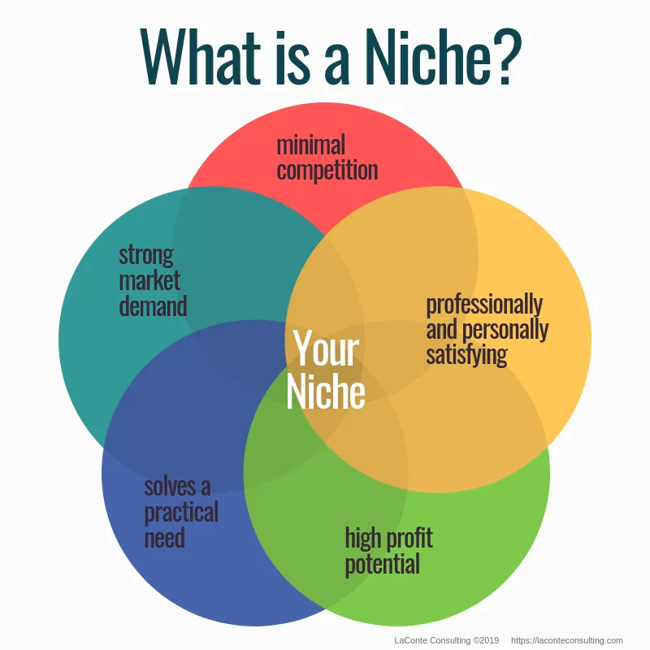
KNOWING WHERE YOUR IDEA FITS

Slide 19
How to Determine Where your Business Fits
Niche Business
SWOT Analysis
Strengths
What makes your services the top tool for addressing consumers need?
Weaknesses
What aspects of your company has room for growth?
Opportunities
What are consumers craving?
What does community need?
Threats
What obstacles do you forsee challenging your company’s success

Slide 20
Why must you know where your idea fits?
Do the right thing
The right way
At the right time
The right place
The right people
For right reason

